Slide 1

Case Assessment| India Aviation & Aerospace Market
1
© TechSci Research

Slide 2
India Aviation & Aerospace Market
S. No. | Table of Contents | Page No.
1. | Research Methodology | 3
2. | Overview | 4
3. | Commercial Aviation Companies | 5
4. | Aviation MRO (Maintenance Repair and Overhaul) | 7
5. | Aviation Assembly & Components Manufacturing Company/Suppliers | 8
6. | Joint Ventures | 9
7. | Government Initiatives in Aviation Sector | 10
8. | Sustainability Programs | 12
Note(s): (a) Robotic patents till 2019 is sourced from public domain, from 2019 onwards data is forecasted considering market trends, historic curve and expected growth rate,
Sources: Center for Security and Emerging Technology

Slide 3

India Aviation & Aerospace Market
Research Methodology
Market assessment for “India Aviation & Aerospace Market”
Research Objective
The primary objective of this research is to analyze the dynamics of the India aviation market, including its segments, trends, and competitive landscape. The study seeks to identify the key drivers and inhibitors shaping the market's growth trajectory.
In the market study, we have focused on commercial aircraft industry of India which includes the commercial airlines, manufacturing and maintenance, repair, and operations (hereafter used MRO as acronym) companies.
Data Collection
Data is sourced from authoritative reports, industry publications, academic journals, government publications. This data is crucial for conducting a comprehensive literature review and historical analysis of the aviation market in India
Data Analysis
Quantitative analysis involves the use of calculation to interpret numerical data. Data related to market size, passenger traffic, fleet size, and financial performance of aviation companies will be analyzed using descriptive and statistical techniques.
Qualitative analysis includes thematic analysis of textual data collected through Themes, patterns, and trends identified through qualitative analysis contribute to a deeper understanding of ongoing trend in industry.
Competitive Landscape
The competitive landscape will be evaluated through an assessment of key players, their market share, strategies, and innovations. This analysis aims to provide a snapshot of the market's competitive dynamics and identify emerging players.
3

Slide 4

India Aviation & Aerospace Market
Overview
Commercial Aircraft Fleet Size (FY21-FY26)
Passenger Traffic Carried by Scheduled Carriers (FY21-FY26)
Aviation MRO Market, USD billion (FY21-FY26)
CAGR 4.70%
CAGR 8.87%
Key Takeaways
Fueled by growing passenger traffic and escalating investments in India’s aviation and aerospace sector, the Indian aircraft industry projects CAGR growth of 8.9% (2021-2031), surpassing the global rate of 5.6%.
Economic growth, post COVID-19 surge in tourism, expanding middle class economy, increased airport accessibility, improving regional connectivity, and growing business opportunities is bolstering air traffic passenger growth.
Domestic passenger traffic in India is set to grow at a CAGR of 9.82% between FY2023- FY2026, while international passenger traffic is expected to exhibit 11.49% CAGR over the same period.
India ranks third globally in commercial plane purchases trailing only the United States and China with orders for over 1,000 aircrafts in FY2023.
Increase in orders are expected to generate a demand for 200 to 300 significant maintenance checks each year onwards fueling the growth of aviation MRO.
Sources: DGCA(Directorate General of Civil Aviation), Ministry of Civil Aviation, Press Release, Company Annual Report.

Slide 5












India Aviation & Aerospace Market
Commercial Aviation Companies
Airline
Headquarters
Revenue (FY2022)
Market Share (FY2022)
Fleet Size (FY2023)
Key Insights
Gurugram
3,162.30
42%
International Expansion
Indian airlines are expanding their international footprints, particularly in the Middle East, Southeast Asia, and Europe.
For instance, IndiGo will be adding an 174 weekly international flights between June and September 2023, including new destinations, routes, and frequencies.
Partnerships and alliances with foreign carriers are being formed to increase global reach.
315
New Delhi
2,086.00
26%
129
Bengaluru
230.20
3%
28
Gurugram
799.67
10%
55
Gurugram
637.37
8%
60
New Delhi
87.50
1%
22
Mumbai
510.21
6%
0
Domestic Growth and Connectivity
Expansion of regional airports and government initiatives (Udan scheme) enhance domestic connectivity.
Boeing projects India will be needing 2,210 new planes in the next two decades, of which1,983 units will be single-aisle jets used for domestic purposes
The number of operational airports in the country has doubled from 74 in 2014 to 148 in 2023
Mumbai
116.21
1%
6
Bengaluru
19.32
0.20%
8
Gurugram
7.01
0.10%
3
Sources: DGCA(Directorate General of Civil Aviation), Ministry of Civil Aviation, Press Release, Company Annual Report.
Note: Revenue in USD Million

Slide 6
India Aviation & Aerospace Market
Commercial Aviation Companies
Aviation Companies Market Share (%) in terms of Market Demand, FY2023
Aviation Companies Market Share (%) in terms of Passenger Carried, FY2023
Aviation Companies Market Share (%) in terms of Operating Fleet, FY2023
Key Takeaways
IndiGo Airlines holds a significant position in the Indian aviation market, capturing a major share of around 54.7% in market demand, 56.40% in terms of passenger carriage, and 46.74% in terms of their operating fleet. This demonstrates the airline's substantial influence and popularity within the industry.
IndiGo's dominance spans across various aspects of the aviation market, indicating its effective management not only in passenger demand but also in fleet management and overall operational efficiency.
Indigo has placed a firm order of 500 Airbus A320 Family planes. This creates a huge record in the history of commercial flying also it is the largest single purchase ever valued at a whopping USD50 billion.
Air India has placed order of 250 Airbus aircraft and 220 new Boeing jets, which together are valued at USD70 billion.
Sources: DGCA(Directorate General of Civil Aviation), Ministry of Civil Aviation, Press Release, Company Annual Report.

Slide 7
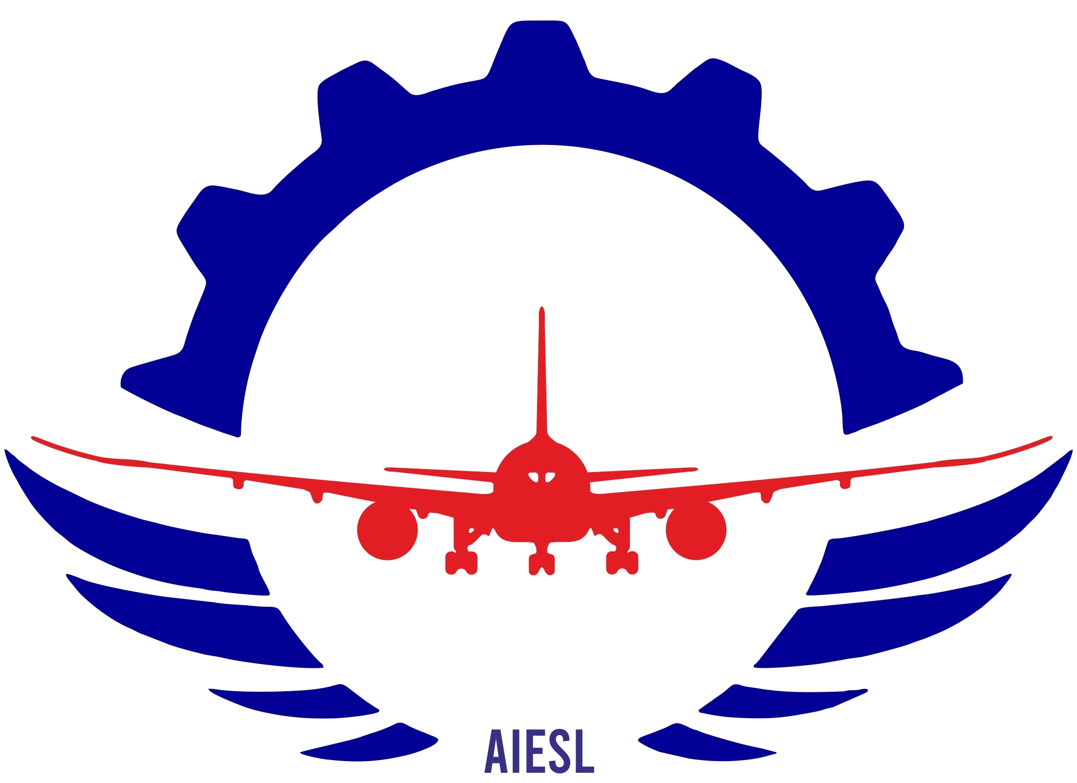




India Aviation & Aerospace Market
Aviation MRO (Maintenance Repair and Overhaul)
Annual MRO Growth (%) by Region for 2021-2031
Company | Company | MRO Type | Presence (India)
 | AI Engineering Services Ltd(AIESL) | Line MRO, Components/ Avionics MRO, Engine MRO, Base MRO. | Delhi, Hyderabad
 | Air Works India (Engineering) Pvt. Ltd. | Line MRO, Base MRO. | Delhi, Jaipur, Ahmedabad, Chennai, Pune, Hubli, Coimbatore and Hyderabad, Mumbai
 | Indamer Aviation Pvt. Ltd. | Line MRO, Components/ Avionics MRO, Base MRO. | Mumbai, Ahmedabad, Chennai, Hyderabad
 | Hindustan Aeronautics Limited (HAL) | Line MRO, Components/ Avionics MRO, Engine MRO, Base MRO. | Banglore
 | GMR Aero Technic Ltd. | Line MRO, Base MRO | Hyderabad
MRO Share, by Type (%) FY2023
Key Takeaways
In 2021, the MRO sector's market size in India was USD 1.7 billion and is projected to grow to USD 4.0 billion by 2031 at a CAGR of 8.9%, surpassing the global average of 5.9% as per NITI AAYOG.
Global aerospace companies such as Boeing and Pratt & Whitney have formed key partnerships with Indian firms for MRO activities. Boeings collaboration with Air Works focuses on Indian Navy and Air Force MRO. Boeing's BIRDS Hub aims to develop MRO skills. Pratt & Whitney partnered with AIESL for turbofan engine maintenance.
Fixing engines and components makes up around 60% to 70% of MRO expenses, while the remaining 30% to 40% is allocated for airframe maintenance and others.
Sources: DGCA(Directorate General of Civil Aviation), Ministry of Civil Aviation, Press Release, Company Annual Report.

Slide 8
India Aviation & Aerospace Market
Aviation Assembly & Components Manufacturing Company/Suppliers
Company | Ownership (Private/ Public) | Field of Specialization | Location | Clientele
Hindustan Aeronautics Limited (HAL) | Public | Avionics, engines and components manufacture. Aircraft and helicopter Manufacture. | Bengaluru | Airbus, Boeing, Eurocoptor.
Tata Advanced Systems Limited | Private | Aerostructures and Aero engines assembly and sub-assembly. Unmanned Aerial Systems. Composites. | Hyderbad | Sikorsky, Lockheed Martin, Boeing.
Mahindra Aerospace | Private | Aerostructures assembly and components. | Bengaluru | Boeing, Airbus, Dassault Aviation, HAL, GE Aviation.
Taneja Aerospace and Aviation Limited | Private | Aircraft subcomponents manufacture. Aerostructures sub-assembly & final assembly. Composites manufacture. | Bengaluru | HAL, NAL.
Dynamitic Technologies | Private | Aerospace components. Airframe structures assembly. | Bengaluru | Airbus, Boeing, HAL.
Alpha Design Technologies Pvt Ltd. | Private | Aircraft parts. Communication systems and equipment Rf signal generator and Rf communication systems. | Bengaluru | HAl.
JINDAL UDYOG INDIA | Private | Aircraft parts Aircraft engine components. | Agra | HAL
Ankit Fasteners | Private | Aircrafts screw & bolts. | Bengaluru | Boeing, Airbus, GE Aviation.
Rhinotech JK Engineering | Private | Aircraft engine components. | Ludhiana | NA
Superteck Engineering | Private | Aircraft parts Aircraft engine components. | Rajkot | NA
Sources: DGCA(Directorate General of Civil Aviation), Ministry of Civil Aviation, Press Release, Company Annual Report.

Slide 9
India Aviation & Aerospace Market
Joint Ventures
Name | Announced Date | Deal Rationale | Location | JV Partners
Safran Helicopter Engines and Hindustan Aeronautics Limited (HAL) | July 2022 | This collaboration marks India's first in house engine design and manufacturing effort. This joint venture will be focused on the complete lifecycle of helicopter engines from design and development to production, sales and support. | Bengaluru | Safran- 50% HAL-50%
Tata Boeing Aerospace Limited (TBAL) | 2016 | Established a joint venture to manufacture aero-structures for Boeing's AH-64 Apache helicopter, encompassing components like fuselages, secondary structures, and vertical spar boxes to cater to global customers. | Hyderabad | Tata Advanced Systems Limited- 51% Boeing- 49%
Snecma and HAL | July 2022 | Established a collaborative partnership to manufacture aero engine components for the Rafale's M88 engine. | Bengaluru | Snecma-50% HAL-50%
Vman Aviation Services and Hindustan Aeronautics Limited (HAL) | Oct 2022 | This collaboration leverages the expertise of both entities to facilitate the availability and accessibility of locally-produced aircraft for lease in the aviation market. | Gujarat | Vman Aviation Services- 51% Hindustan Aeronautics Limited (HAL)- 49%
Jio-bp | June 2019 | The joint venture focuses on expanding fuel and convenience retailing, including aviation fuels in India. It aims to rapidly increase the current network to 5,500 outlet, providing modern high-quality service with distinct offerings for Indian consumers. | Gandhinagar | Bharat Petroleum – 49% Reliance Industries Limited- 51%
Indo-Russian Helicopters Limited. | May 2017 | Production & supply of Kamov-226T helicopters in India. | Bengaluru | HAL : 50.5% Russian Helicopters : 42% Rosoboronexport Russia : 7.5%
Samtel HAL Display System Ltd. | Aug 2012 | This joint venture to producing a range of display systems for airborne, military, and ground applications, intended for sale both within India and in international markets. | Bengaluru | HAL : 40% Samtel Group India: 60%
Tata Lockheed Martin Aerostructures Limited (TLMAL) | June 2010 | This joint venture to manufacture the F-16 Block 70 in India. This initiative transforms India into the sole assembly and integration center for the aircraft a total of around 3,200 of which are operational. | Hyderabad | Tata Advanced Systems Limited- 51% Lockheed Martin-49%
Tata-Airbus consortium | Oct 2022 | Manufacture C295MW transport aircraft and The production facility will serve both the export of transport aircraft and fulfill additional orders from the Indian Air Force | Gujarat | Vman Aviation Services- 51% Hindustan Aeronautics Limited (HAL)- 49%
Dassault Reliance Aerospace Limited | Sept 2016 | This joint venture was formed to undertake the assembly of aerostructure sub-assemblies for Falcon 2000 commercial aircraft and also for sub-assemblies of Rafale Fighter Aircraft. | Nagpur | Dassault Aviation-49% Reliance Defence-51%
Sources: DGCA(Directorate General of Civil Aviation), Ministry of Civil Aviation, Press Release, Company Annual Report.

Slide 10
India Aviation & Aerospace Market
Government Initiatives in Aviation Sector
In the fiscal year 2023-24, an allocation of Rs. 3,224.67 crore (US$ 440.36 million) has been designated for the Ministry of Civil Aviation in the Union Budget.
In the 2022-23 budget, the Regional Connectivity Scheme (RCS) UDAN, designed to enhance regional air connectivity, has been granted an allocation of Rs. 601 crore (USD 77.52 million).
Budget Allocations for Civil Aviation Ministry and Regional Connectivity Enhancement
NABH (NextGen Airports for Bharat) - Nirman is a governmental effort aimed at increasing airport capacity by over fivefold to accommodate billions of annual journeys within the upcoming 10-15 years.
To achieve the PM-Gati Shakti vision effectively, Minister of Civil Aviation Mr. Jyotiraditya M. Scindia urges collaborative efforts between Central and State Governments for constructing 16 new airports in Madhya Pradesh, Chhattisgarh, Uttar Pradesh, Rajasthan and Maharashtra.
Expanding Capacity and Collaborative Growth
Mr. Jyotiraditya Scindia, the Union Minister for Civil Aviation, has introduced the Digi Yatra initiative for three airports in the nation. The phased implementation of Digi Yatra is underway across various airports. The inaugural phase commenced on December 1, 2022 with Mr. Jyotiraditya M. Scindia, the Union Minister of Civil Aviation and Steel, launching it at Delhi, Bengaluru, and Varanasi Airports. The first phase of Digi Yatra is also scheduled for implementation at Kolkata, Pune, Vijayawada, and Hyderabad Airports by March 2023.
Digi Yatra Initiative at Major Indian Airports
Sources: DGCA(Directorate General of Civil Aviation), Ministry of Civil Aviation, Press Release, Company Annual Report.

Slide 11
India Aviation & Aerospace Market
Government Initiatives in Aviation Sector
The Ministry of Civil Aviation (MoCA) is positive that individuals aspiring to become commercial pilots will soon have the opportunity to receive training in India itself, without having to go abroad. To make this happen, the government announced in July 2021 that it plans to create eight new flying schools at five different airports Belagavi and Kalaburagi in Karnataka, Jalgaon in Maharashtra, Khajuraho in Madhya Pradesh and Lilabari in Assam.
Government's Plan to Establish New Flying Schools in India for Aspiring Commercial Pilots
In June 2022, Shri Jyotiraditya M. Scindia, the Minister of Civil Aviation, introduced the National Air Sport Policy (NASP) 2022. NASP 2022 envisions positioning India as a prominent sports nation by 2030 through the establishment of a secure, cost-effective, accessible, enjoyable, and sustainable air sports environment. Air sports encompass a range of activities involving the sky, such as air racing, aerobatics, aero modeling, hang gliding, paragliding, paramotoring, skydiving and more.
Vision for Thriving Air Sports in India
Over the upcoming five years, the Airports Authority of India (AAI) intends to allocate Rs. 25,000 crore (US$ 3.58 billion) to enhance airport facilities and infrastructure.Mr. Jyotiraditya Scindia, the Minister of Civil Aviation, has stated that India's goal is to establish 220 additional airports by 2025. Additionally, there are plans to boost cargo flights for perishable food items to 30%, introducing 133 new flights in the upcoming years.
Under Union Budget 2021-22, the government lowered the custom duty from 2.5% to 0% on components or parts, including engines, for manufacturing of aircrafts by public sector units of the Ministry of Defence.
Expansion Targets and Policy Reforms for Advancing Indian Aviation Infrastructure
Sources: DGCA(Directorate General of Civil Aviation), Ministry of Civil Aviation, Press Release, Company Annual Report.

Slide 12
India Aviation & Aerospace Market
Sustainability Programs
Under the guidance of the World Economic Forum (WEF), SpiceJet unveiled an ambitious objective in June 2021 is to transport 100 million domestic passengers using a blend of Sustainable Aviation Fuel (SAF) by 2030.
By the year 2024, JetSetGo, a private aviation company is aiming to achieve carbon neutrality for its flight operations through the implementation of a carbon management program announced in September 2021.
The Airports Authority of India (AAI) has introduced a novel initiative called the Sustainable Green Airports Mission (SUGAM) with the objective of enhancing the sustainability and carbon neutrality of its airports. The primary goal of SUGAM is to minimize the environmental effects resulting from airport operations. This is to be achieved by advocating the adoption of renewable energy sources, implementing energy efficient practices and initiating various sustainability measures .
Through the Sustainable Green Airports Mission, AAI intends to significantly decrease the carbon footprint of its airports by transitioning to cleaner energy sources such as solar or wind power and by implementing energy efficient technologies and practices. This involves adopting energy saving lighting systems, optimizing heating, cooling, and ventilation systems and exploring innovative ways to manage waste and reduce water consumption.
AirAsia India achieved a significant milestone on May 19 when it became the first airline in the country to conduct a commercial flight using sustainable aviation fuel (SAF) produced domestically. Moreover, this accomplishment occurred shortly after Vistara operated a flight between New Delhi and Mumbai, incorporating a 17 percent blend of sustainable aviation fuel (SAF).
The International Air Transport Association aims to eliminate carbon emissions by 2050 and India plans to do the same by 2070. India is starting with small actions to reach these big goals. IATA includes around 300 airlines, which make up 83 percent of the world's air travel.
Sources: DGCA(Directorate General of Civil Aviation), Ministry of Civil Aviation, Press Release, Company Annual Report.

